Slide 1
SOCIAL MEDIA
The Impact of Social Media on Modern Society
Submitted to:
Ajit Ojha
Submitted by:
Ishan Giri
Roll no:17

Slide 2

Introduction:
What is Social Media?
A place to connect: It is a collection of apps and websites that let us create and share content like photos, videos, and thoughts instantly
Virtual Hangout: Its like a giant digital park where people from all over the world meet to talk and hang out.
Not only chatting: We use it for many things now, like watching news, shopping, learning new skills, and even finding jobs.

Slide 3


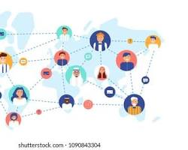
The Positive Impact:
Educational Resources: Instant access to tutorials, global news, and expert opinions.
Community Building: Finding groups with shared interests or supporting social causes.
Skill Development: Learning digital literacy, content creation, and marketing.

Slide 4
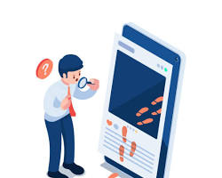
Challenges and Risks:
Mental Health: The link between excessive "screen time" and anxiety or decreased self-esteem.
Privacy & Security: The importance of protecting personal data and understanding algorithms.
Digital Footprint: How what we post today can affect our future college or job opportunities.

Slide 5
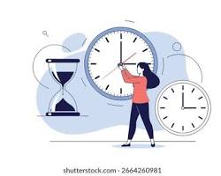
How to Use It Wisely:
Time Management: Utilizing "Do Not Disturb" modes and setting app limits.
Critical Thinking: Verifying information before sharing to stop the spread of "fake news."
Protect Your Privacy: Check your settings often. Keep your personal info (like your home address or school) private.

Slide 6
Conclusion:
Social media is a powerful tool that requires a balance of fun and responsibility.
Control Social Media by you; don't let Social Media control you.
Keep your private information private.
At the end; Social media should be used to enhance your life, not replace it.

